Slide 1
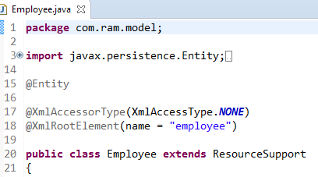
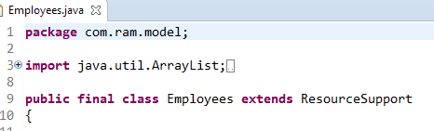
Spring Boot HATEOAS Example
In this Spring HATEOAS example, we will learn to add HATEOAS links to existing REST APIs created in a spring boot project. We will use the class org.springframework.hateoas.ResourceSupport along with org.springframework.hateoas.mvc.ControllerLinkBuilder and org.springframework.hateoas.Link classes provided by spring HATEOAS module.
Extend all model classes where you want to add HATEOAS links – with org.springframework.hateoas.ResourceSupport class.

Slide 2
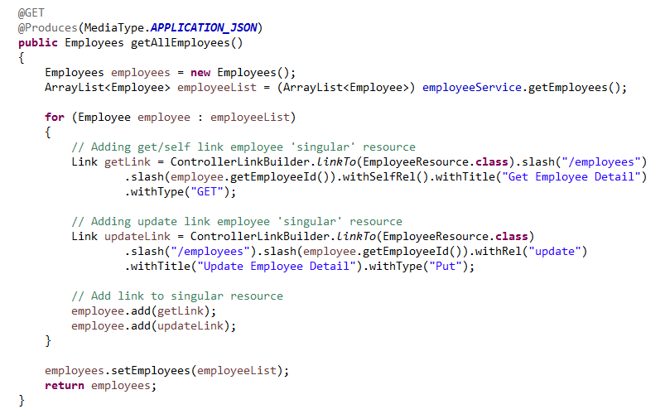
Spring Boot HATEOAS Example
To add links, you will need ControllerLinkBuilder and Link classes. Link is the final representation of link to be added in REST resource. Whereas ControllerLinkBuilder helps in building the links using it’s various method based on builder pattern.

